Slide 1


模拟电子技术基础
Analog Device
6 Feedback amplifier circuit
反馈放大电路
陈晓龙 Chen, Xiaolong
Department of Electrical and Electronic Engineering

Slide 2
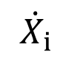
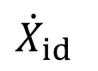
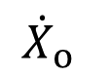

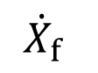

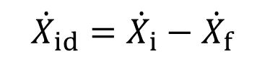




6.3 The effect of negative feedback on amplifier circuit
+
Open-loop gain 开环增益
Close-loop gain 闭环增益
Gain with feedback反馈增益
Feedback factor 反馈系数
Loop gain 环路增益

Slide 3

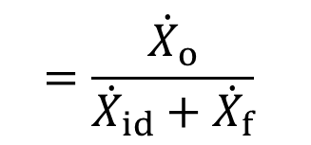
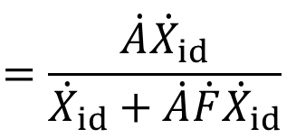
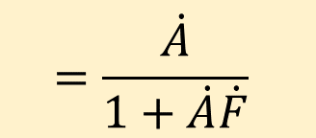
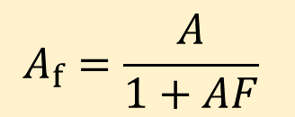
Close-loop gain 闭环增益

Slide 4
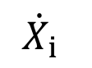
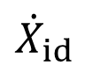
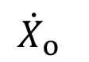

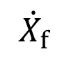


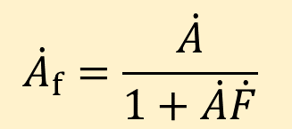
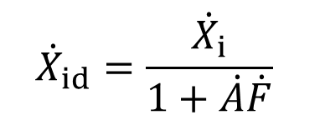
+
No feedback circuit:
With feedback circuit:
This is because the net input signal for amplification:

Slide 5
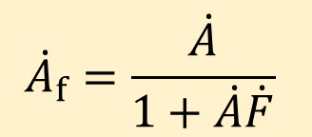
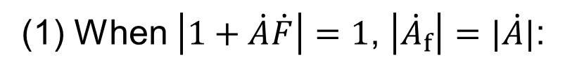
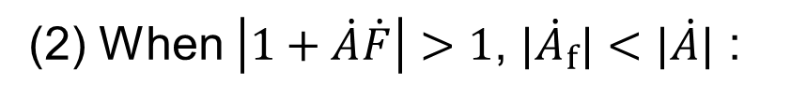
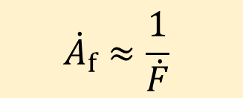

Close-loop gain 闭环增益
no feedback
negative feedback
Strong negative feedback 深度负反馈

Slide 6
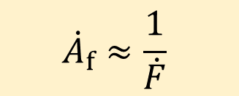

Strong negative feedback 深度负反馈
The close-loop gain only depends on the feedback network.
Since feedback network is usually made of resistors and capacitors, the amplifier circuit is very stable.

Slide 7
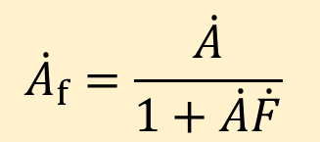
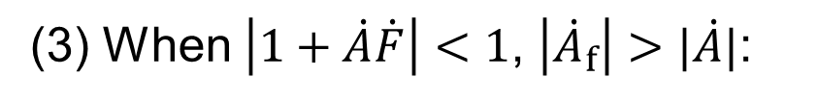

Close-loop gain 闭环增益
positive feedback
There is output signal when no input signal.
This is called self-excited oscillation 自激振荡

Slide 8
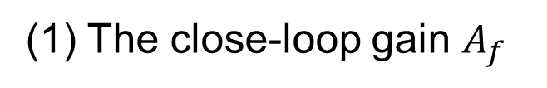
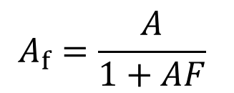
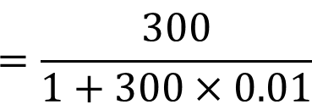

Q1: There is a feedback amplifier circuit with open-loop gain of A=300 and feedback factor of F=0.01, ask:

Slide 9
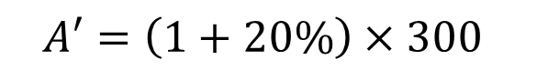

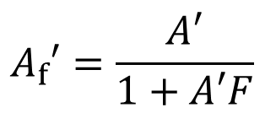
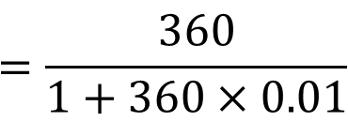

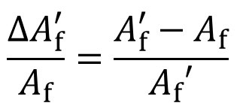
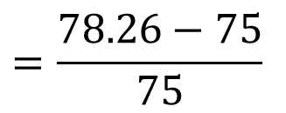

Q1: There is a feedback amplifier circuit with open-loop gain of A=300 and feedback factor of F=0.01, ask:

Slide 10
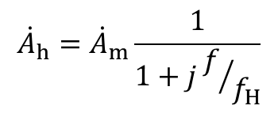
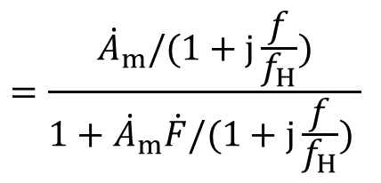
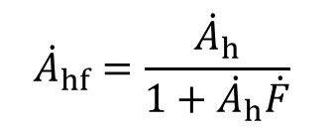
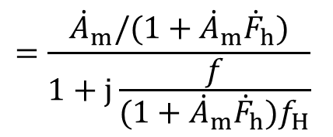
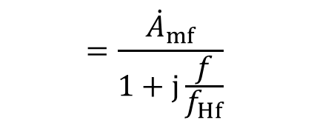
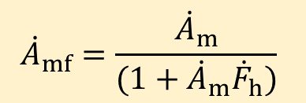
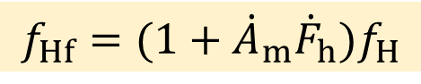
Bandwidth of negative feedback circuit: high-f region
No negative feedback:
With negative feedback:

Slide 11
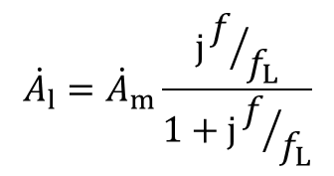
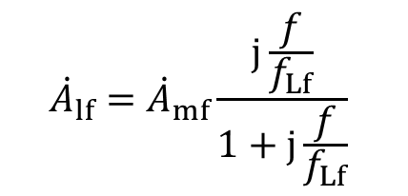

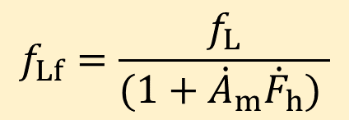
Bandwidth of negative feedback circuit: low-f region
No negative feedback:
With negative feedback:

Slide 12
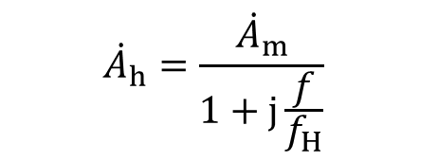
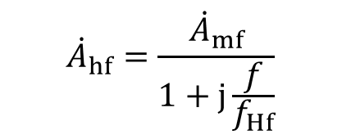

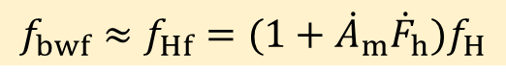

Bandwidth of negative feedback circuit
No negative feedback:
With negative feedback:
Bandwidth gain product 带宽增益积
The bandwidth increases at the cost of gain

Slide 13
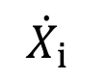
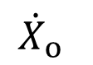

Negative feedback decreases the non-linear distortion
减小非线性失真
Non-linear distortion!
i_{B}
Q_{i} is too low
Q_{i}
0
u_{BE}

Slide 14
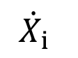
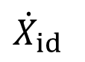
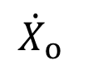

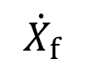

Negative feedback decreases the non-linear distortion
减小非线性失真
1
2
5
3
6
+
4

Slide 15
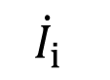





















Effect of negative feedback on input resistance
(1) Series negative feedback
Input resistance increase!

Slide 16
























Effect of negative feedback on input resistance
(2) Parallel negative feedback
Input resistance decrease!

Slide 17






























Effect of negative feedback on output resistance
+
(1) Voltage negative feedback
+
Output resistance decrease!

Slide 18




























Effect of negative feedback on output resistance
(2) Current negative feedback
+
+
Output resistance increase!

Slide 19






Summary
Series negative feedback
Parallel negative feedback
Voltage negative feedback
Current negative feedback
Constant-voltage source恒压源
Constant-current source恒流源

Slide 20
How to choose the right negative feedback type to design electronic circuits? 如何正确选择负反馈类型进行电路设计？
For voltage amplifier:
Choose voltage series negative feedback
For current amplifier:
Choose current parallel negative feedback
For voltage-current converter:
Choose current series negative feedback
For current-voltage converter:
Choose voltage parallel negative feedback

Slide 21


How to choose the right negative feedback type to design electronic circuits? 如何正确选择负反馈类型进行电路设计？
选择合适的反馈深度
1. Use integrated operational amplifier 采用集成运算放大器
3. Design feedback network

Slide 22










Example 1: To stabilize the AC output voltage u_{o}, the feedback resistor is put between X and X Points.
V_{CC}
C
B
T₁
T₂
A
D
F
E

Slide 23









Example 2: To stabilize the AC output voltage u_{o}, the feedback resistor is put between X and X Points.
+V_{CC}
D
E
A
B
u_{O}
C
u_{I}
R_{E}
-V_{EE}

Slide 24


Slide 25





6.4 Amplifier circuit with strong negative feedback
Close-loop gain 闭环增益
This is called strong negative feedback 深度负反馈.
The close-loop gain only depends on the feedback network.
Since feedback network is usually made of resistors and capacitors, the amplifier circuit is very stable.

Slide 26















For strong negative feedback:
Virtual short circuit
For series feedback:
Virtual open circuit

Slide 27















For strong negative feedback:
For parallel feedback:

Slide 28


Slide 29


Slide 30




















Separate amplifier circuit and feedback network分离放大电路和反馈网络
+
Feedback network
Voltage feedback
Current feedback
~
~
~
~

Slide 31


















Example 1: Voltage series negative feedback 电压串联负反馈
Close-loop gain
Feedback network
Non-inverted input scaling amplifier
Independent of load resistor!
同相输入比例放大器

Slide 32





















Example 1: Voltage series negative feedback 电压串联负反馈
Input resistance:
Feedback network
Output resistance:

Slide 33






















Example 2: Voltage parallel negative feedback 电压并联负反馈
Close-loop gain
Feedback network
Voltage gain

Slide 34







Example 2: Voltage parallel negative feedback 电压并联负反馈
Input resistance:
Feedback network
Output resistance:

Slide 35























Example 3: Current series negative feedback 电流串联负反馈
Close-loop gain
Feedback network
Voltage gain

Slide 36



















Example 3: Current series negative feedback 电流串联负反馈
Input resistance:
Output resistance:

Slide 37


























Example 4: Current parallel negative feedback 电流并联负反馈
Close-loop gain
Feedback network
Voltage gain

Slide 38




Example 4: Current parallel negative feedback 电流并联负反馈
Input resistance:
Output resistance:
Feedback network

Slide 39



























Example 5:
(1) Find the feedback network for AC circuit
Feedback network

Slide 40





Example 5:
(2) Negative or positive AC feedback circuit
Negative feedback!

Slide 41

Example 5:
(3) Judge the type of AC negative feedback circuit
Voltage series feedback 电压串联负反馈

Slide 42


Example 5:
(4) Feedback factor and close-loop gain

Slide 43




Example 5:
(5) Input resistance

Slide 44

Example 5:
(6) Output resistance

Slide 45






















Example 6:
(1) Find the feedback network for AC circuit
Feedback network

Slide 46






Example 6:
(2) Positive or negative feedback for AC circuit?
Negative feedback

Slide 47


Example 6:
(3) Judge the type of AC negative feedback circuit

Slide 48
Example 6:
(3) Judge the type of AC negative feedback circuit
Current parallel feedback 电流并联负反馈

Slide 49



























Example 6:
(4) Feedback factor and close-loop gain

Slide 50







Example 6:
(5) Close-loop voltage gain

Slide 51




Example 6:
(6) Input resistance

Slide 52









Example 6:
(7) Output resistance

Slide 53













Negative feedback circuit with ideal operational amplifier
理想运放的负反馈电路
An ideal case of strong negative feedback 深度负反馈的理想情况
Ideal operational amplifier
Virtual short circuit
Virtual open circuit

Slide 54





Example 1: Voltage series negative feedback 电压串联负反馈
Close-loop gain
Ideal operational amplifier
Strong negative feedback!
The result is the same as that using the separation method 分离法

Slide 55















Compare
Strong negative feedback
Ideal operational amplifier
+

Slide 56






6.5 Self-excited oscillation in negative feedback circuits
负反馈电路中的自激振荡
Close-loop gain
Self-excited oscillation 自激振荡:
There is output AC signal when no input AC signal.

Slide 57













Self-excited oscillation 自激振荡:
+

Slide 58














Start-oscillation condition起振条件:
Perturbation signal can be amplified
Positive feedback
+

Slide 59












+
This is the self-excited oscillation

Slide 60






When oscillation is stable:
+
Start-oscillation condition起振条件:

Slide 61
Q1: Is there self-excited oscillation in one-stage amplifier circuit?
Q2: Is there self-excited oscillation in two-stage amplifier circuit?
Q3: Is there self-excited oscillation in three-stage amplifier circuit?

Slide 62











High frequency: Amplitude and phase frequency characteristics
One-stage amplifier
-20dB/dec
3 dB
20 dB
Phase at most changes -90º, no self-excited oscillation

Slide 63




-20dB/dec
Two-stage amplifier
-40dB/dec
Phase at most changes -180º, f_{o} is infinite
No self-excited oscillation

Slide 64








-20dB/dec
Three-stage amplifier
-40dB/dec
Phase at most changes -270º
-60dB/dec
Self-excited oscillation is possible!

Slide 65

Multistage amplifier is more easier to generate the self-excited oscillation (at least three stage).

Slide 66


How to judge the stability of the negative feedback circuit
怎样判断负反馈电路的稳定性

Slide 67






















Unstable
Stable

Slide 68



How to judge the stability of the negative feedback circuit
怎样判断负反馈电路的稳定性

Slide 69

















Gain and phase stability margin 幅值和相位稳定裕度
Stable

Slide 70
Gain and phase stability margin 幅值和相位稳定裕度
Stable

Slide 71

Methods to eliminate the self-excited oscillation
消除自激振荡的方法
Compensation补偿
Add resistor and capacitor in the amplifier circuit, to increase the gain and phase stability margin.
Lag compensation 滞后补偿
Lead compensation 超前补偿

Slide 72













Lag compensation 滞后补偿
-20dB/十倍频
N-stage
-40dB/十倍频
-20dB/十倍频
-60dB/十倍频
-40dB/十倍频
:No self-excited oscillation

Slide 73




Lag compensation 滞后补偿
-20dB/十倍频
N-stage
-40dB/十倍频
-20dB/十倍频
-60dB/十倍频
-40dB/十倍频
Before compensation:
After compensation:

Slide 74
Homework：Refer to blackboard

